Slide 1
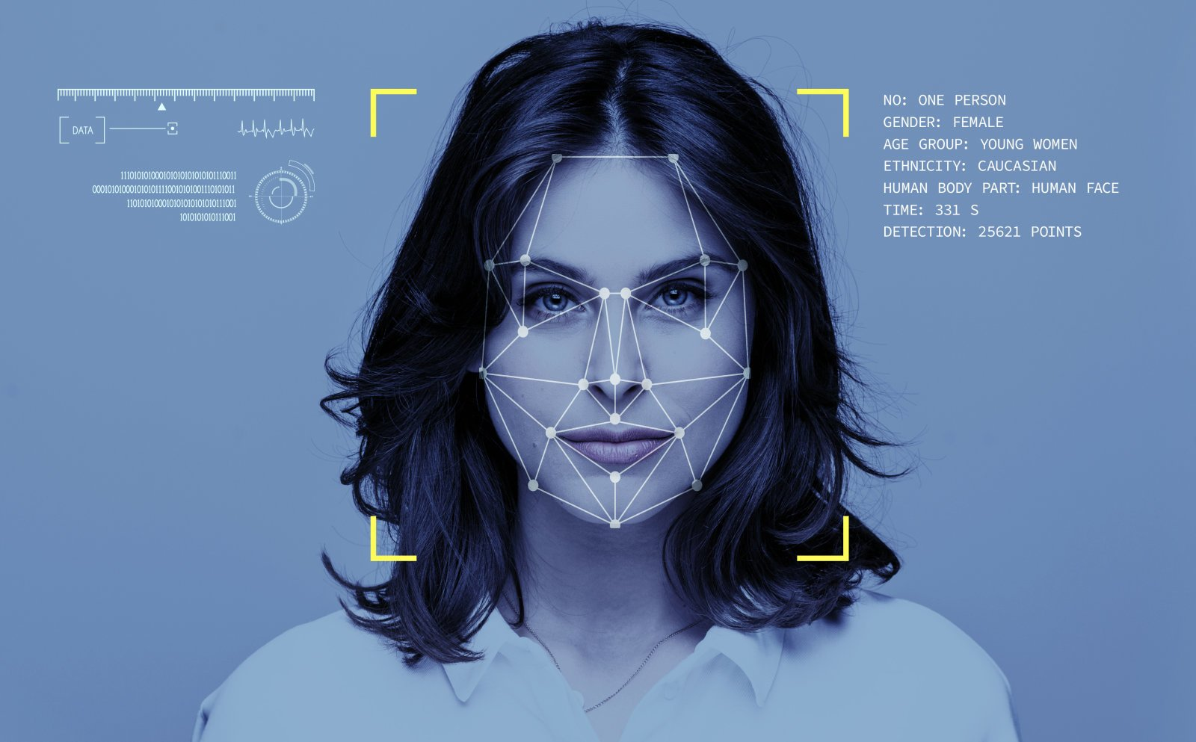

BY P. SINDHU 21751A3131 K. VAISHALI 21751A3115 P. SANJANA 21751A3126 M. SREE VAISHNAVI 21751A3143
SREENIVASA INSTITUTE OF TECHNOLOGY AND MANAGEMENT STUDIES
(Autonomous)
DEPARTMENT OF CSE -ARITIFICIAL INTELLIGENCE
(2023-2024)
FINAL PROJECT SKILLS
ON
AGE DETECTION USING DEEP LEARNING
Under the Guidance of
Dr. N. GAYATRI DEVI
Associate Professor
Department of CSE-Artificial Intelligence ,
Sreenivasa Institute of Technology and
Management Studies, Chittoor, A.P.

Slide 2
Contents
Abstract
Algorithm
Dataset Description
Problem Identification
Objectives
Existing Methodology
Demerits
Proposed Method
Merits
Block Diagram
Modules of System
Conclusion
Reference

Slide 3
Abstract
The age detection technology will also underline its importance and how it may be used to better our everyday lives.
CNN methods have been used for classification and regression, there are multi layers have been included they are input layer, convolutional layer, pooling layer, fully connected layer.
The classified layers are executed in hidden layers by using “UTK DATASET”
There are datasets which are already trained for predicting age they are called “EPOCHS”.
According to the social media, there has been an increased in automatic age classification through facial images.
The age detection technology will also underline its importance and how it may be used to better our everyday lives.

Slide 4
Algorithm
CONVOLUTION NEURAL NETWORK:
It is a type of Deep learning neural network architecture, which is mainly used to detect an object.
Input Layer: This layer takes in the raw input data, such as an image, and passes it to the next layer.
Convolutional Layers: These layers apply convolution operations to the input data. Each convolutional layer consists of multiple edges,
Activation Layers: After each convolutional layer, an activation function like ReLU (Rectified Linear Unit) is applied element-wise to introduce non-linearity into the network.
Pooling Layers:These layers reduce the spatial dimensions of the feature maps produced by the convolutional layers, helping in reducing computation and controlling overfitting

Slide 5
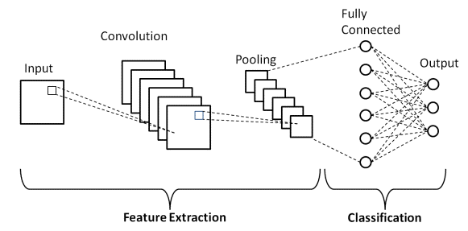
Algorithm
Fully Connected Layers :In the final layers of a CNN, fully connected layers are used for classification or regression tasks. These layers connect every neuron from the previous layer to every neuron in the current layer.
Output Layer: The output layer produces the final predictions based on the features extracted by the previous layers. The number of neurons in this layer depends on the task at hand.

Slide 6
Dataset Description
UTK Face dataset is a large-scale face dataset with long age span (range from 0 to 110 years old).
The dataset consists of over 20,000 face images with annotations of age, gender, and ethnicity.
The images cover large variation in pose, facial expression, illumination, occlusion, resolution, etc.
This dataset could be used on a variety of tasks, e.g., face detection, age estimation, age progression/regression, landmark localization, etc.

Slide 7
Problem Identification
In the age detection the problems are risen due to :
Data quality
Data imbalance
Model performance
Generalization
To solve those problems we use few techniques they are:
Define the problem: define the objectives of age detection
Data Collection: Gather a diverse and representative dataset of images or videos with labeled ages.
Data Preprocessing: Clean the dataset by removing outliers, handling missing values, and standardizing the data.
Fine-tuning: Fine-tune hyperparameters such as learning rate, batch size, and model architecture based on performance metrics to improve the model's accuracy.
Training: Split your dataset into training, validation, and testing sets. Train your model on the training data using techniques like stochastic gradient descent (SGD) or Adam optimization. Monitor performance on the validation set to prevent overfitting.

Slide 8
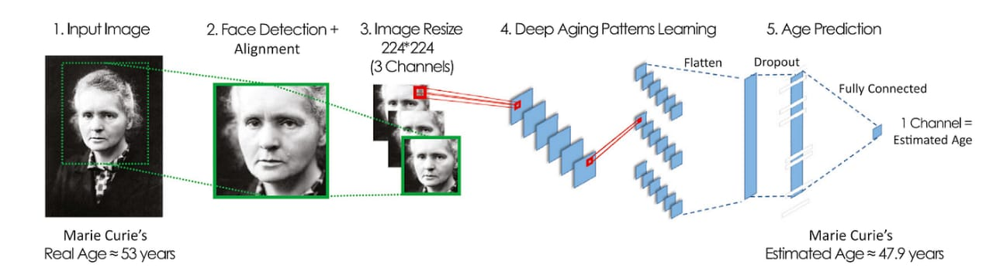
Objectives
Data collection: Gather a large collection of dataset
Preprocessing : which it process the data to ensure consistency include cropping, resizing, etc.
Model selection : choose a deep learning algorithm which is suitable for the labelled dataset.
Model training : train the selected model on labelled dataset
Evaluation Metrix : matrix such as Mean absolute error (MAE), Mean squared error(MSE) model’s performance.
Optimization : improve performance and efficiency of the model
Deployment : deploy the trained model such as facial recognition, age , restriction, filtering, cropping etc.

Slide 9
Existing Methodology
EcascadedAdaboost learning algorithm in face detection and achieved the age Estimation mechanism using Gabor wavelets and OLPP.
His paper is organized in the following sections.
First, our presented face detection System includes histogram lighting normalization, feature selection.
The age estimation process, including the feature extraction ,Feature reduction and selection, and age classification, is then introduced.
There are common approaches include facial recognition algorithms. Which analyze features like wrinkles Models trained on demographic data to predict age based on factors like body language or online behavior.

Slide 10
Demerits
Dataset problem that affect the performance, machine learning on quality of data.
Mislabelled data excessive noise can cause the models to start learning wrong things.
Traditional classification algorithm can not learn the complicated nonlinear relationship in image data.
It cause effect on the private personal problems in social media the images that are trained are may not be more safe.

Slide 11
Proposed Method
To detect age and gender through the given data set. We will use python and Keras methods for detecting age and gender.
Model Architecture Selection, Model Training,Model Evaluation and Fine-Tuning, Model Deployment, the main layers are convolutional and hidden layers.
Pandas, Seaborn, pillow pil, tensorflow are the libraries we have to execute the age prediction.
There are more than 100 epochs we have only used 20 epochs for every frame to consume the time for the execution.

Slide 12
Merits
There are many advantages of age detection
It is easy to recognise people.
It is very useful for authentication, human computer interaction, behavioural analysis.
It can be useful for product recommendations based on preferences.
Many companies needed age and gender data capture.
It can recognise the dead persons image to check for when they were born.

Slide 13
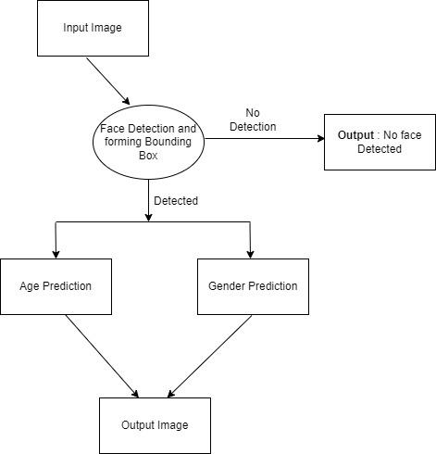
Block Diagram

Slide 14
Modules of the System
The modules that we are used in the age detection are
Pandas-ordinal regression can enhance model performance based on age information.
Seaborn-it help to explore and understand the data in the image.
PIL- Pillow is an updated version of “python image library” or ”PIL”, it supports a range of simple and sophisticated image manipulation functionality
TensorFlow-They are trained on the UTK face dataset which contains 23Kimages with age and gender.

Slide 15


Slide 16


Slide 17


Slide 18
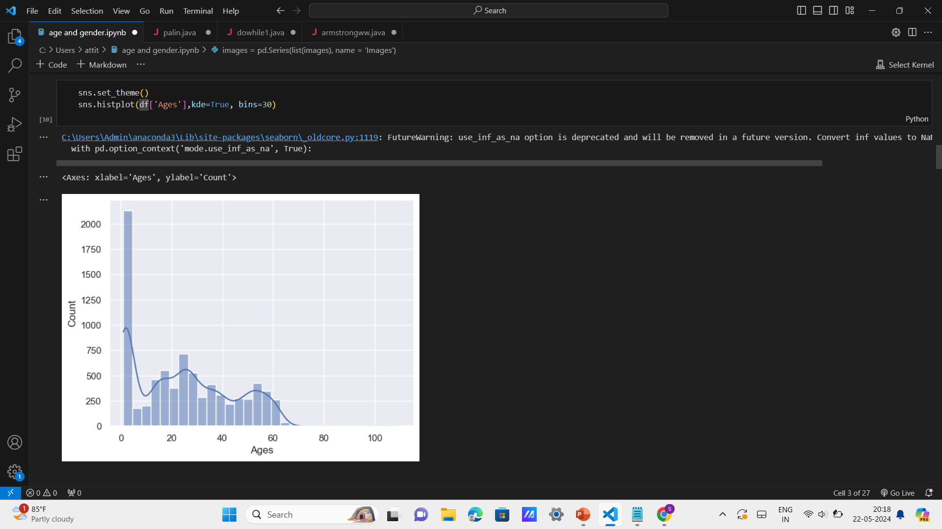

Slide 19


Slide 20
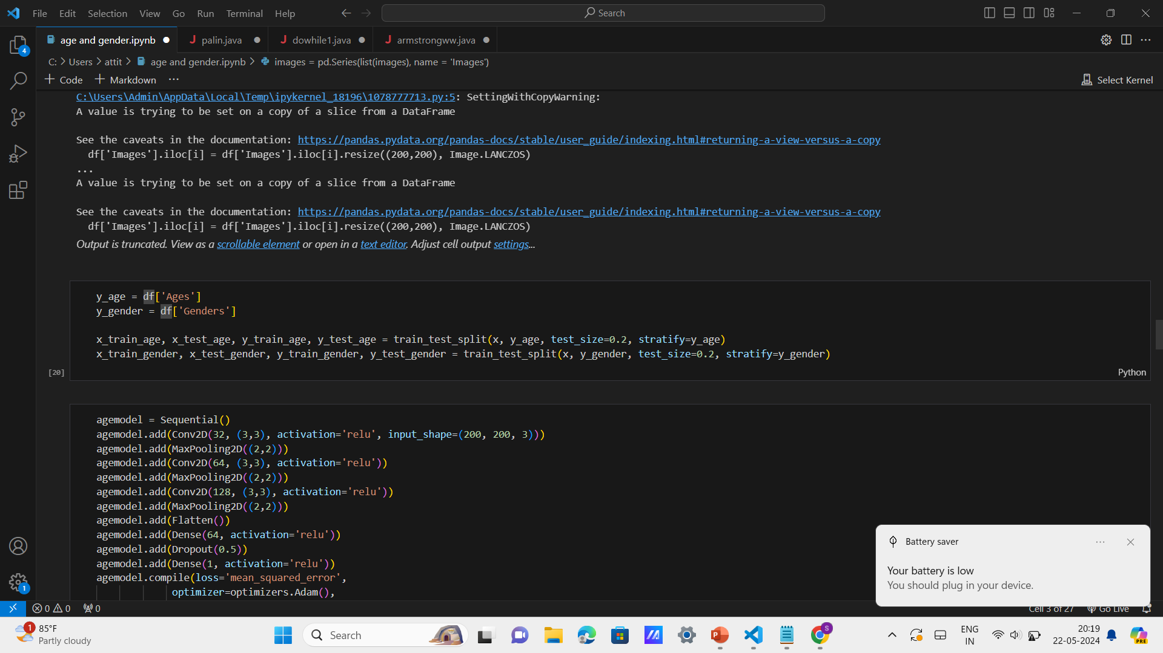

Slide 21
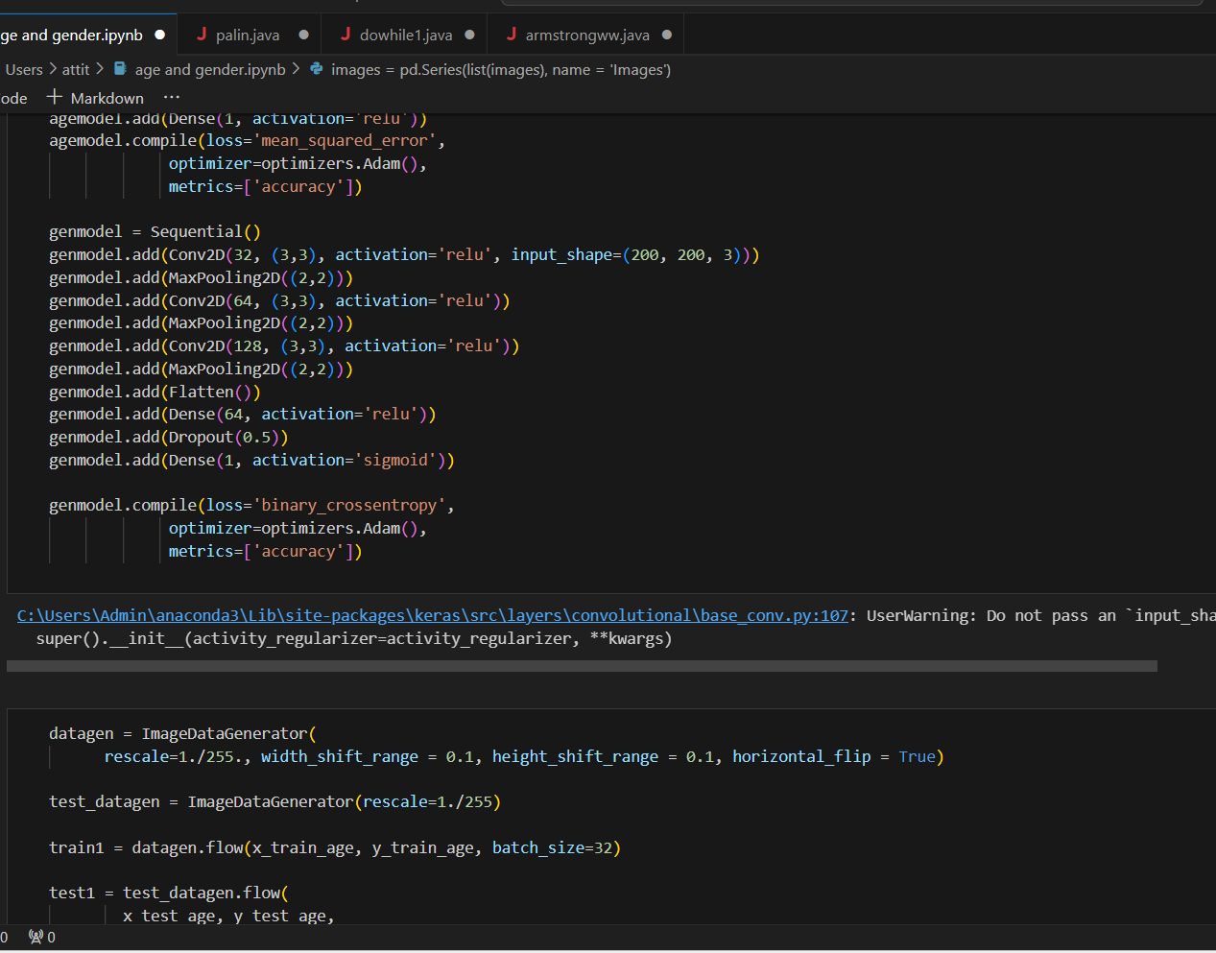

Slide 22
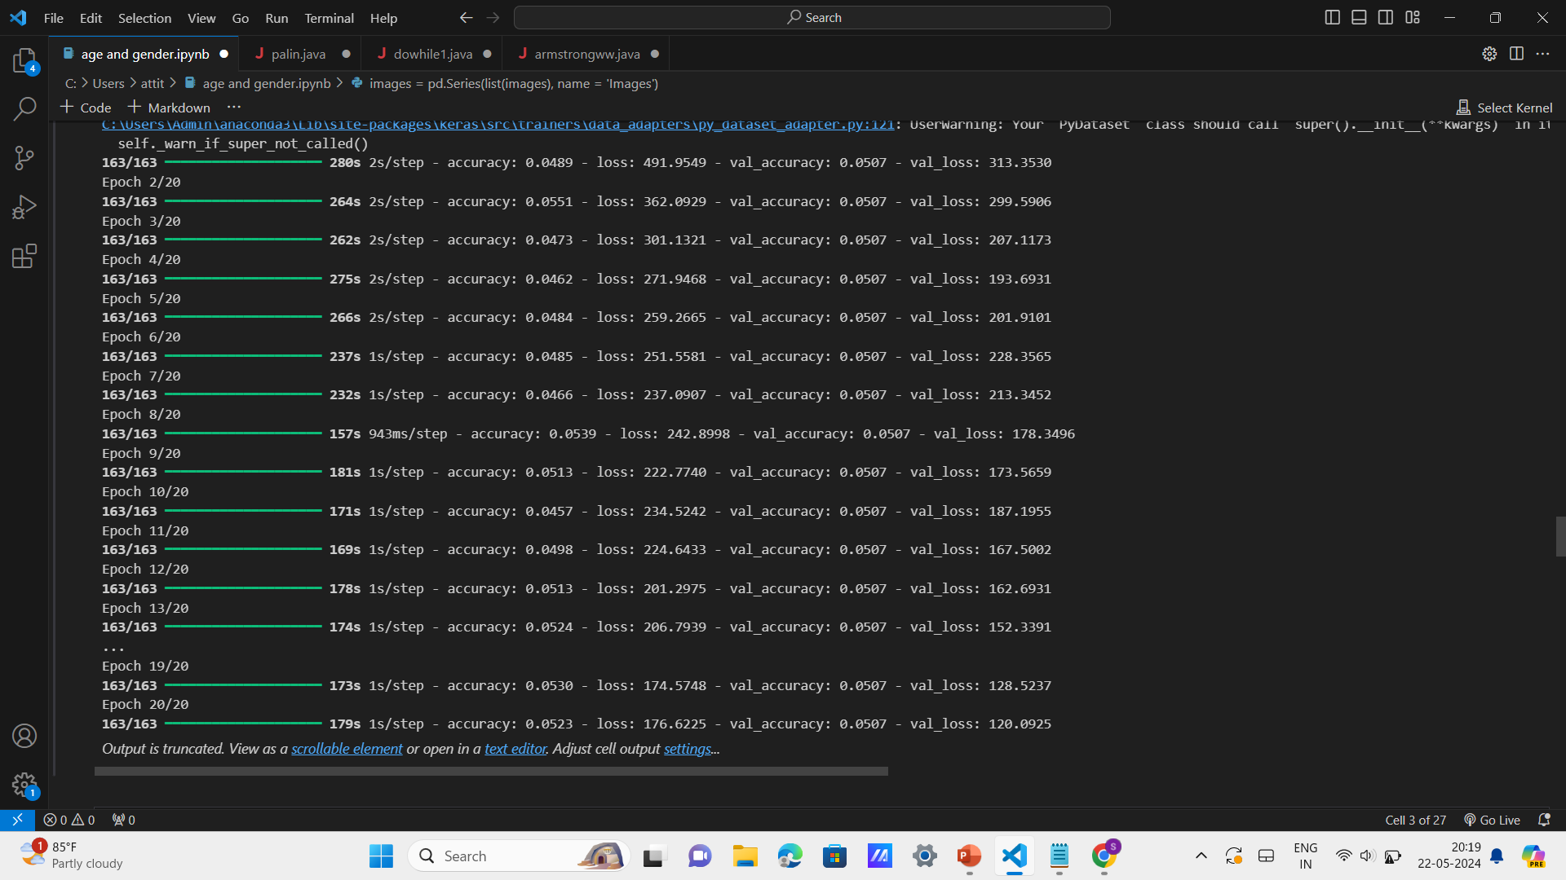

Slide 23
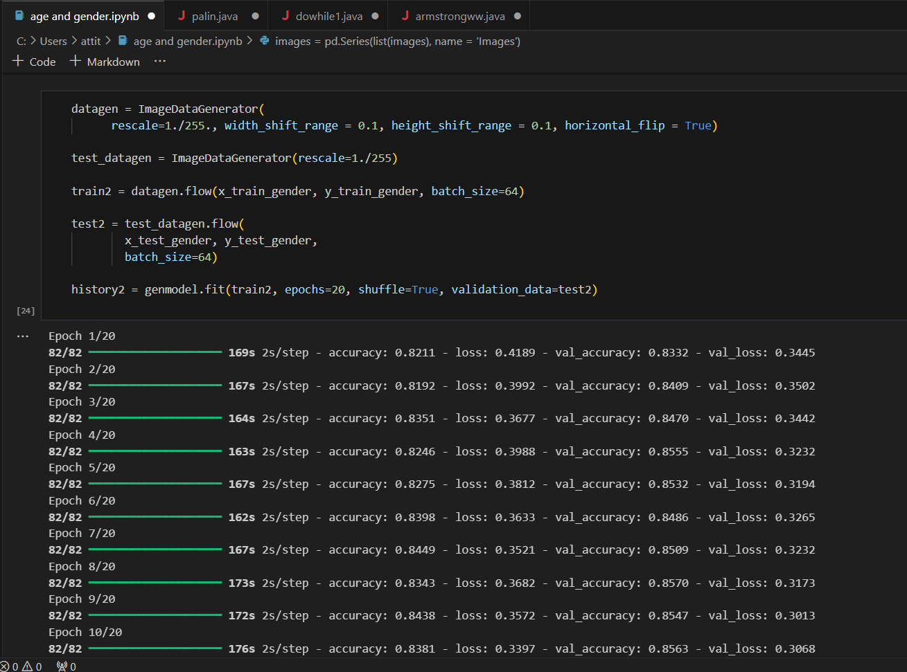

Slide 24


Slide 25


Slide 26
Conclusion
We considered all capturing techniques to capture images automatically and quickly this methodology even exist of gender detect.
We have successfully executed the source code for the age detection.
Here the model can not detect the exact age but it can detect the accurate age.

Slide 27
References
Saxena, A., Singh, P. and Singh, S.N., 2021, January. Gender and age detection using deep learning. In 2021 11th International Conference on Cloud Computing, Data Science & Engineering (Confluence) (pp. 719-724). IEEE.
Refik Can Malli, Mehmet Aygun, Hazim Kemal EkenelProceedings of the IEEE Conference on Computer Vision and Pattern Recognition Workshops, 9-16, 2016
Hyunkwang Lee, Shahein Tajmir, Jenny Lee, Maurice Zissen, Bethel Ayele Yeshiwas, Tarik K Alkasab, Garry Choy, Synho DoJournal of digital imaging 30, 427-441, 2017
Soumaya Zaghbani, Noureddine Boujneh, Med Salim BouhlelComputers & Electrical Engineering 68, 337-347, 2018

Slide 28


